Slide 1



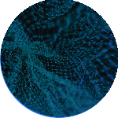

Introduction to Finetuning Large language Models
LLMs)
What is Finetuning? Why Finetuning?
Prompting Engineering vs Finetuning?
Advantages of Finetuning
What is Instruction Finetuning?
Instruction Finetuning in Practice
Training data generation and preprocessing
Model training process Evaluation
Prompt Learning PEFT Techniques
Prompt Tuning Prefix Tuning Adaptation Prompt
Popular PEFT methods in Practice
Low-Rank Adaptation
LoRA and QLoRA methods
IA³ and Adapter methods
Parameter-Efficient Finetuning PEFT
Why PEFT?
What are PEFT techniques?
Different types of PEFT techniques

Slide 2
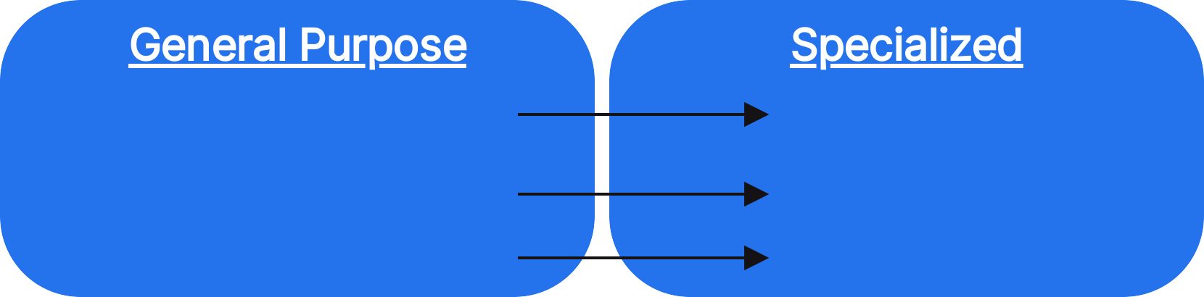
What is Finetuning?
GPT
StarCoder General Practice Lawyer
ChatGPT StarChat IP Lawyer
Adapting pre-trained general-purpose model by training it further to:
specialize at given task(s) by gaining domain knowledge
change model behaviour to provide consistent outputs and better control the tone and style of the outputs
Align model to be helpful, harmless and honest

Slide 3
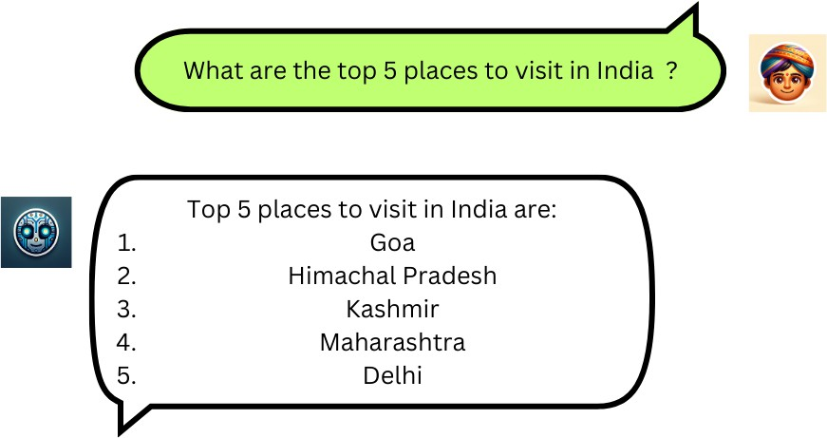
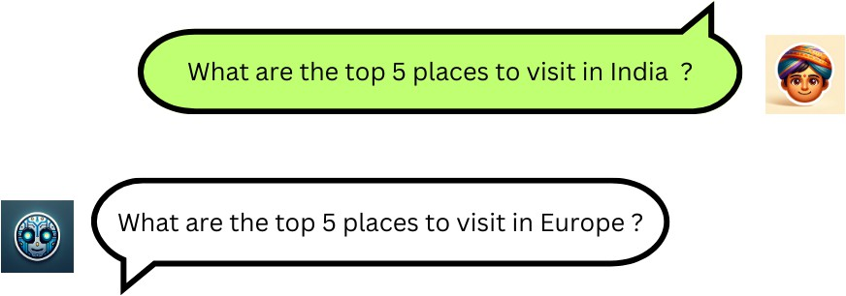


Why Finetuning?
Recipe for getting state-of-the-results in Natural Language Processing NLP domain:
Pretraining on web-scale datasets
Finetuning on downstream task of interest

Slide 4



Using carefully crafted prompts to guide AI responses
Low cost upfront. No need for additional training or data.
User-friendly as it doesn't require technical knowledge
Less Customizable as there is a limit to what one can fit in a prompt. Limited to capabilities of pre-trained model
Accuracy and consistency of outputs is lower. Suits rapid prototyping, POCs and generic domains
Training further on task specific datasets to tailor its responses Higher cost upfront. Involves costs
for training data and computation.
Requires technical knowledge
Highly customizable. Can tailor the model to specific needs. Change the behaviour and gain knowledge for specific task(s)
Accuracy and Consistency are high. Suits Enterprise, production and domain specific use cases.
Prompt Engineering vs Finetuning

Slide 5

Advantages of Finetuning
Performance
Data Privacy and Security
Lower operational costs, Scalability and Reliability

Slide 6
What is Instruction Finetuning?
Training language models to follow instructions with human feedback OpenAI Paper)
Training pre-trained LLMs to follow instructions
Instruction Finetuning
Dataset - Instruction, Inputs, Response) tuples
Answer/mimic like a human in order to behave like a chatbot
ChatGPT, SharChat, Zephyr
Finetuning

Slide 7

Finetuning Process
Data quality is the key during finetuning.
Data gathering and Preprocessing
Evaluation
Training

Slide 8

Starts with no knowledge of the world. Random weights.
The learning objective is to predict the next word, also known as Causal Language Modeling.
Enormous Internet scale datasets - Pile, RedPyjama-2 30 Trillion tokens and 20B documents ), Stack
Self-Supervised learning.
Learns language and compresses the information on the internet.
Starts with pre-trained model which has general world knowledge and language skills.
Learning objective remains the same.
Much less data is required. The numbers of samples are in the order of thousands. Alpaca, OpenAsst- Guanaco, no_robots, Lima
Supervised learning when you curate labelled data (recommended). Also supports Self- Supervised learning.
Gains knowledge of the domain specific tasks/datasets and learns the traits of the task(s) to provide consistent outputs.
Pre- Training vs
Finetuning

Slide 9
Why Finetuning?

Slide 10
Dataset Collection
Annotated data by Skilled Humans
High-quality and diverse dataset created by skilled human annotators.
LIMA, OpenAssistant Conversations Dataset, No Robots

Slide 11
Dataset Collection
LLM assisted Data Generation
Self-Instruct: Aligning Language Models with Self- Generated Instructions
Start with seed instructions, use LLM to generate more instructions, filter them out for quality and diversity, rinse and repeat.
Use prompt template or LLM to generate instructions and input/output pairs for corporate documents, meeting notes, blogposts, wikipedia articles ...
Alpaca, Ultrachat, CodeAlpaca

Slide 12

Dataset Collection
FAQs
Transcribed customer support conversations, meetings, podcasts
Conversations on social media, discord, slack
textbook question and answers, GitHub issues/PR conversations

Slide 13

Remember to consider
Quality
High-quality dataset is the key Avoid Garbage in → Garbage out
Quantity
For instruction finetuning, data in order of thousands of samples is a good starting point
The more the better
Diversity
Diverse tasks enable generalization and serendipity
Source
Human annotated data is the gold standard
LLM generated data often has subtle patterns that can hinder model training

Slide 14

Data Collection Pipeline
Collect Instruction dataset Instruction, Input, Output) tuples
Format and concatenate
Train/Test Split

Slide 15
Training Loop
Dataset
Forward
Things to consider
Hyperparameters
Saving checkpoints at regular intervals
Evaluation on an evaluation dataset
Compute requirements and hardware
Tracking experiments
Loss Computation
Backpropagation
Updating weights

Slide 16
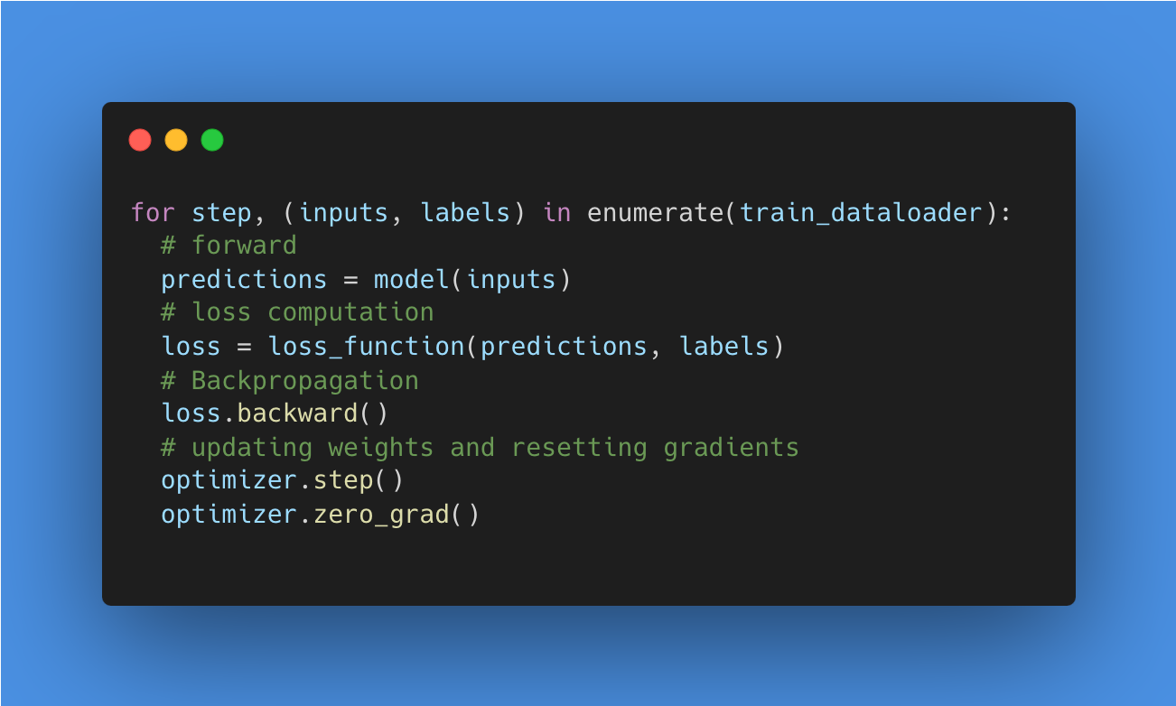
PyTorch training loop code

Slide 17
Training and Inference at Scale
Transformers Trainer API and Accelerate make it easier
Trainer API
Just plug in the model and datasets and call `trainer.train()`. No need to write the boilerplate PyTorch loops.
Accelerate
Training and inference at scale made simple, efficient and adaptable.

Slide 18
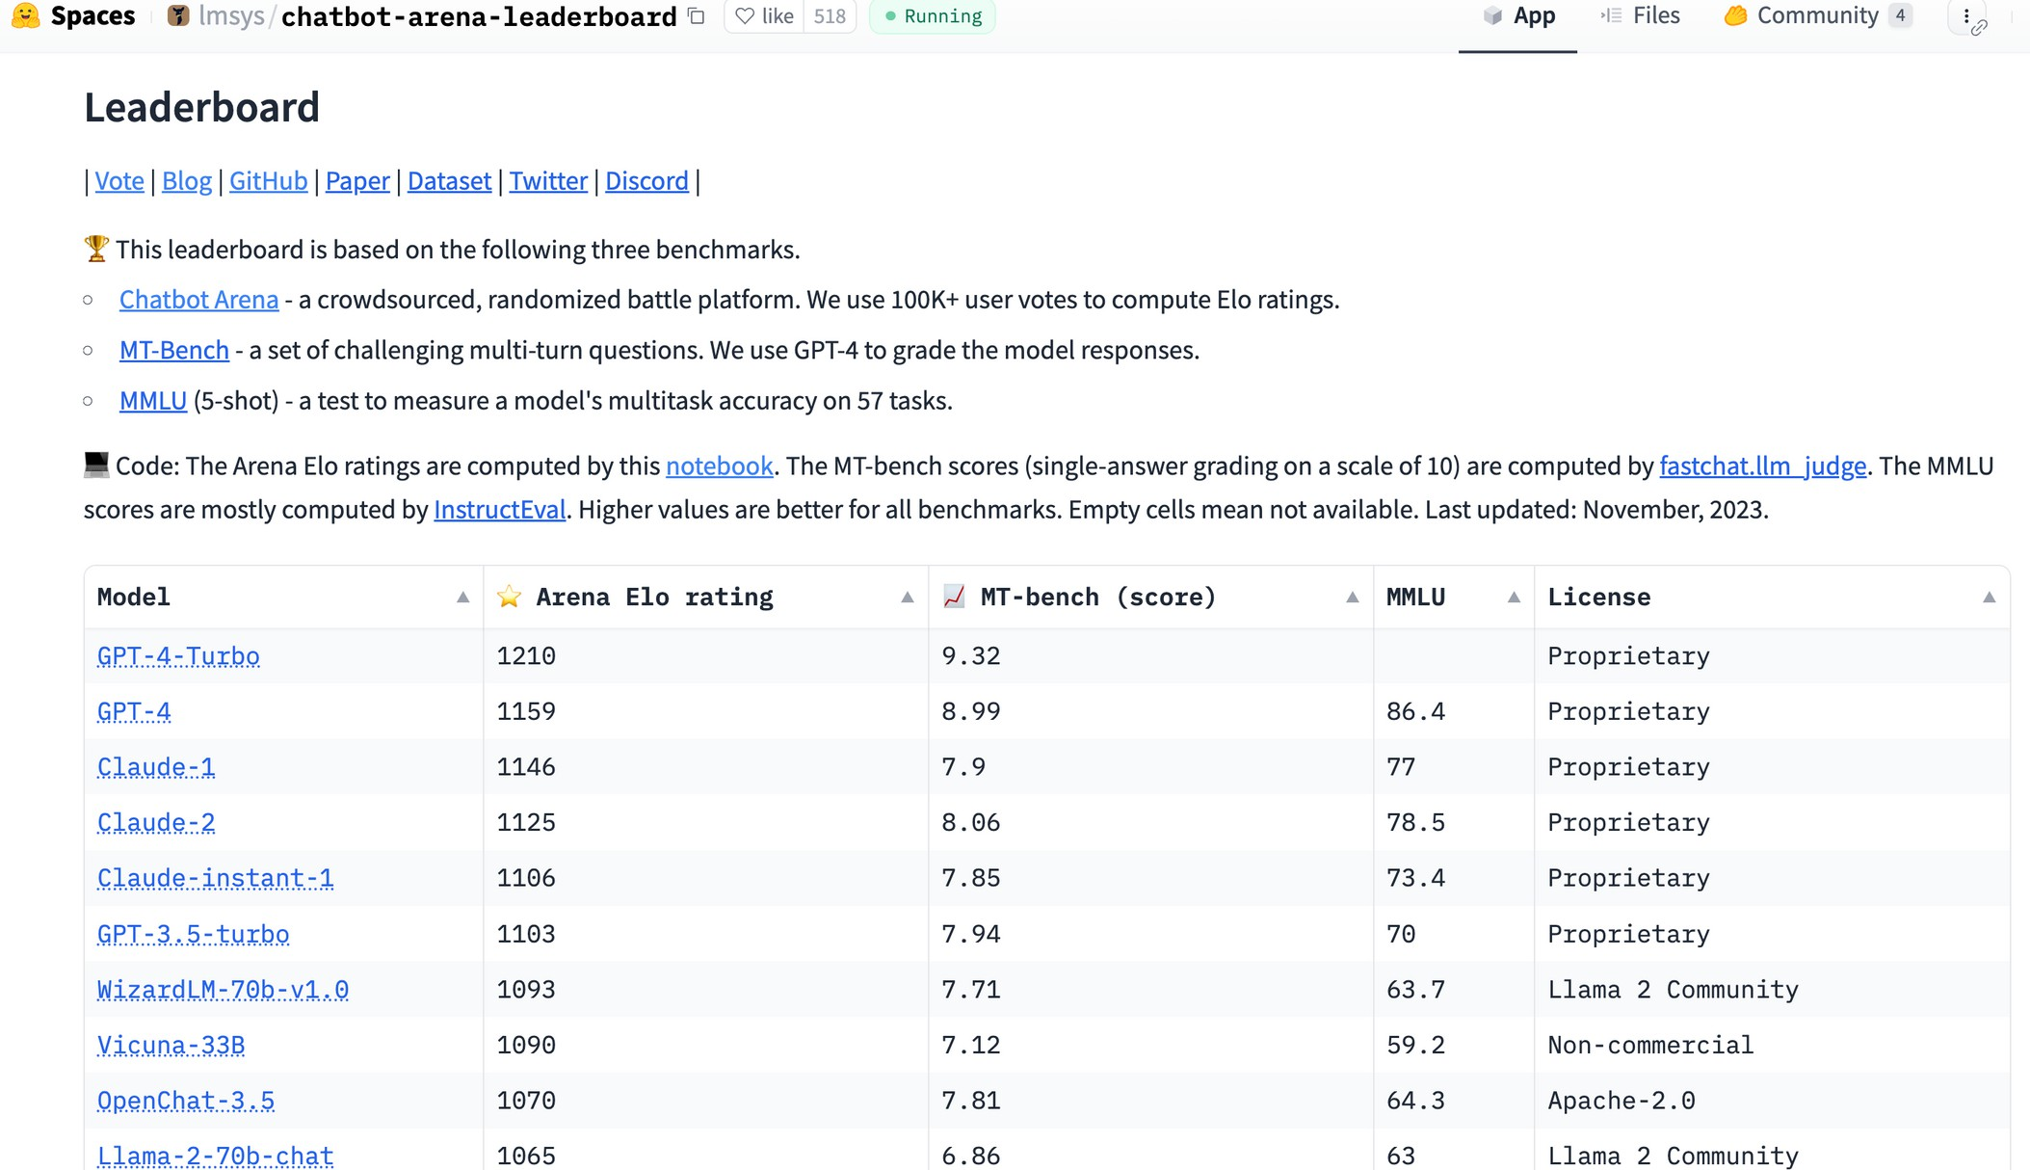
Human Evaluations are the gold standard
THEY PROVIDE TRUE WAY NOW TO PROPERLY GAUGE THE MODEL CAPABILITIES.
CHATBOT ARENA LEADERBOARD

Slide 19
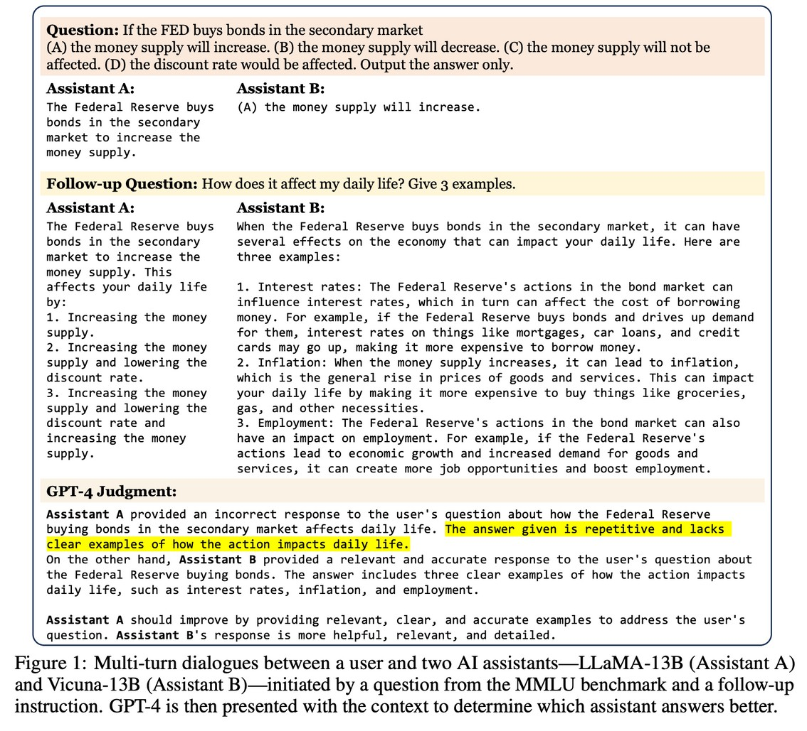
Model Evaluations
USING SOTA MODELS SUCH AS GPT 4 TO EVALUATE THE PERFORMANCE OF OTHER MODELS.
The evaluations can be skewed towards models trained with data generated using the model using the evaluation
JUDGING LLM AS A JUDGE WITH MT BENCH AND CHATBOT ARENA

Slide 20
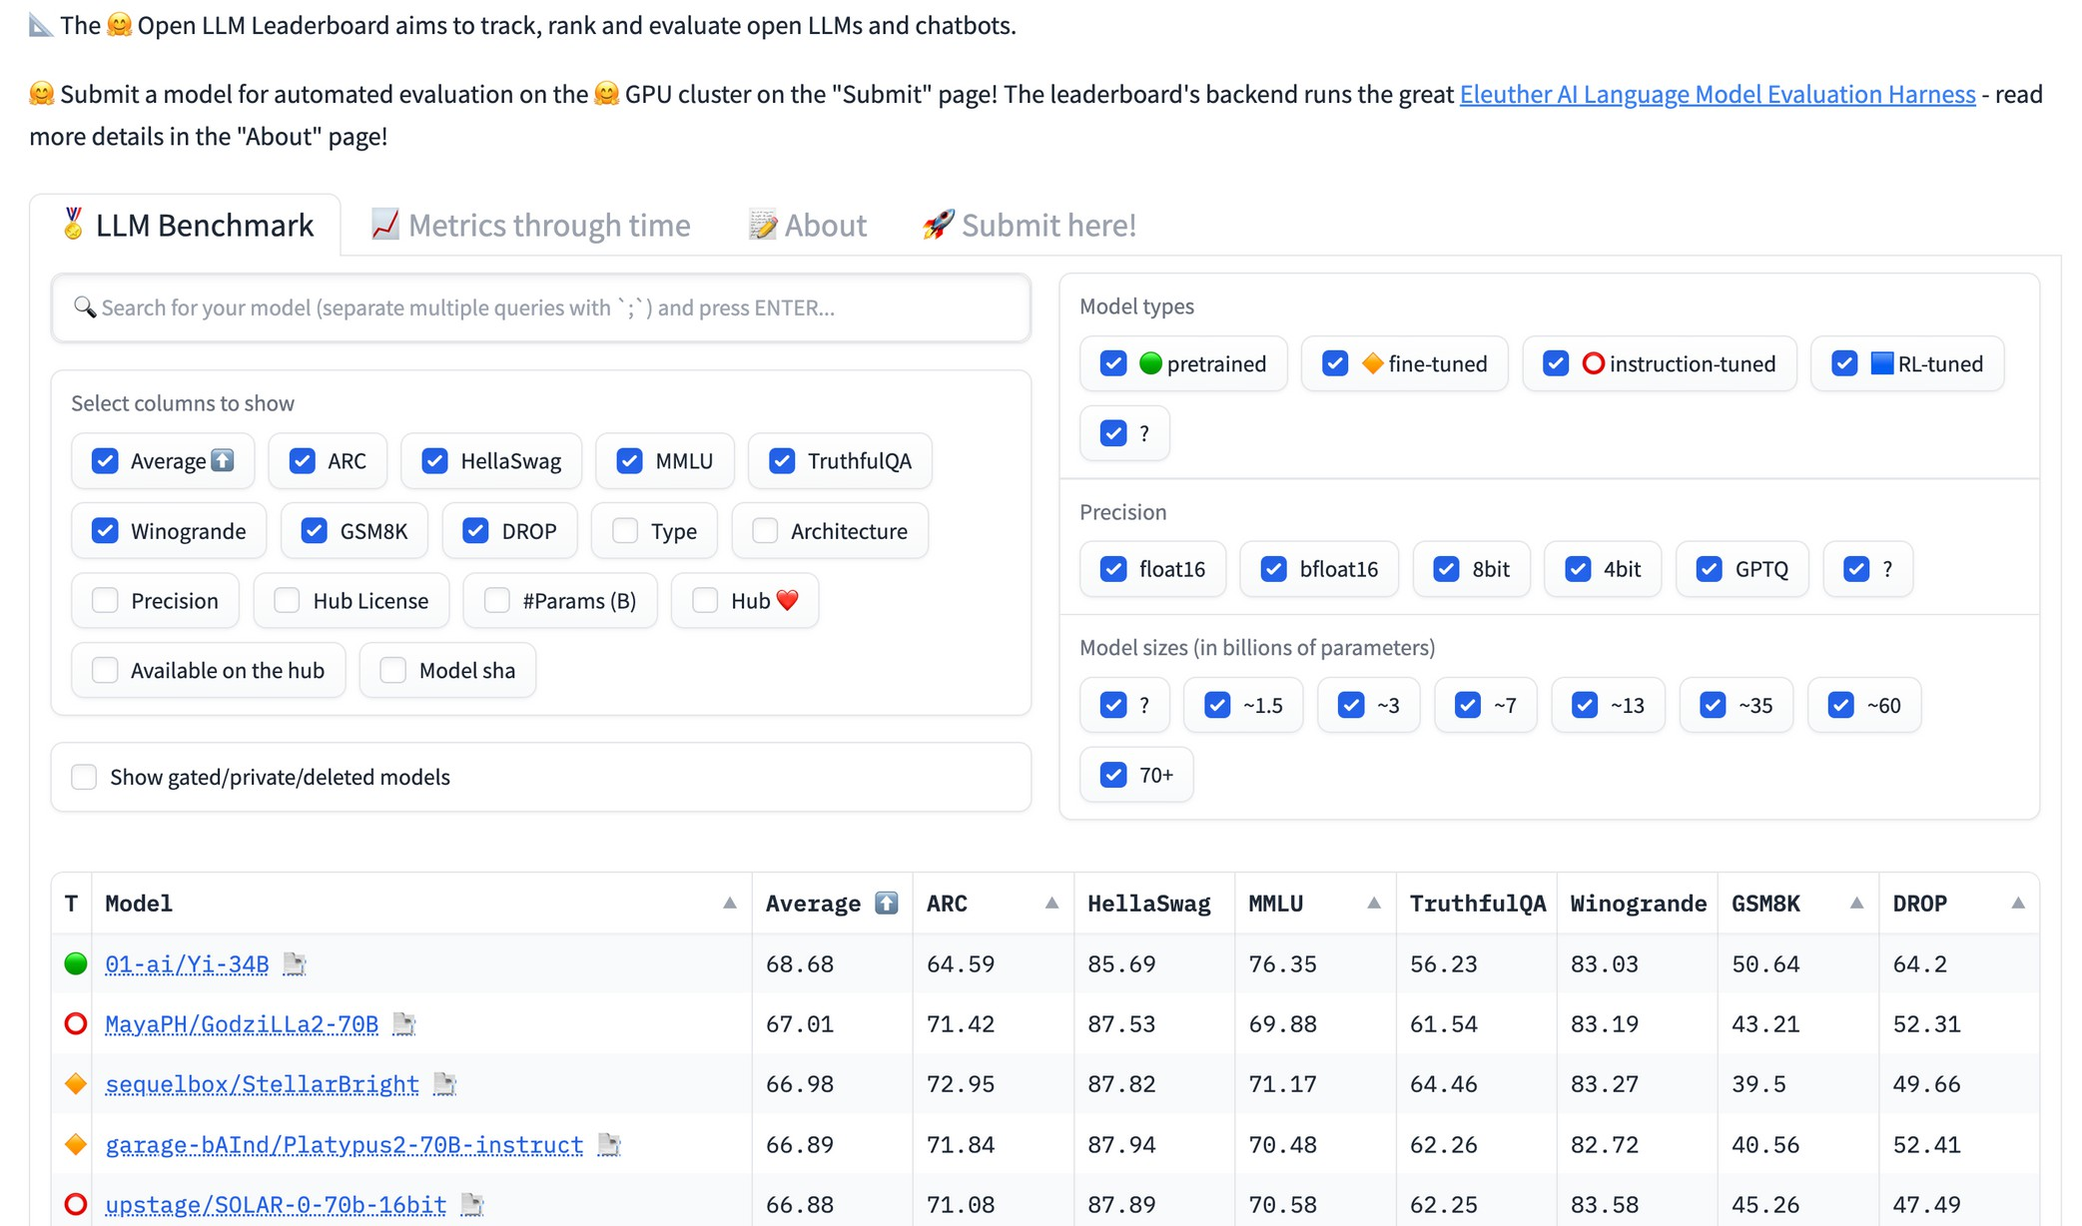
LLM
Benchmarks
A VERY NOISY PROXY. ONLY USEFUL TO GAUGE GENERIC CAPABILITIES OF MODELS.
OPEN LLM LEADERBOARD

Slide 21
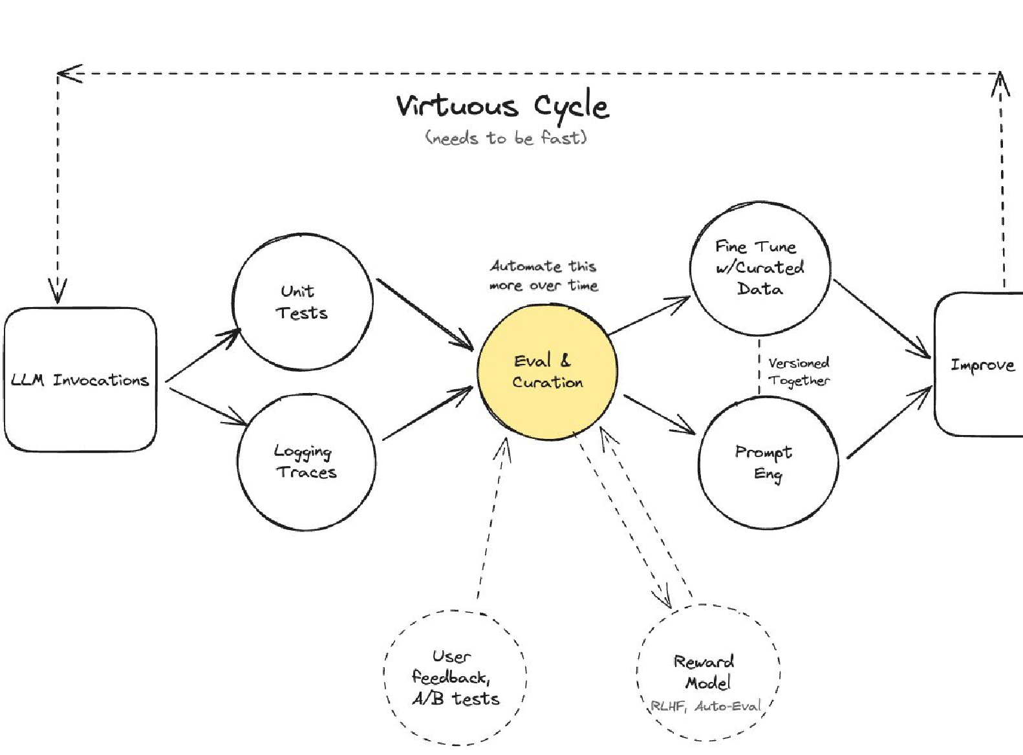
Task Specific Testing Suite
FROM THE TALK DATA AND DEVOPS TOOLS FOR EVALUATING AND PRODUCTIONIZING LLMS

Slide 22
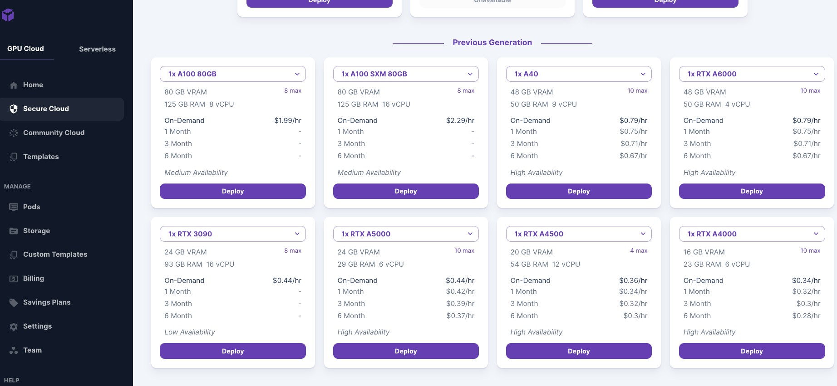
Setting up instance
1
Login to the Runpod website
`https://www.runpod.io/`
2
Choose RTX A6000 instance from the `Secure cloud` tab
3
Choose PyTorch 2.1.1 docker image and increase the storage to 100 GB via `customize deployment` option

Slide 23
Setting up code and installing requirements
1
Upload 'finetuning-llm-code' folder from the Course Handouts using the 'Upload Files' button in the jupyter lab
2
Go into the code repo via `cd finetuning-llm-course` command
3
Install the requirements via `pip install -r requirements.txt`
4
Login to wandb via `wandb login` command
5
Login to Huggingface hub via `huggingface-cli login` command

Slide 24
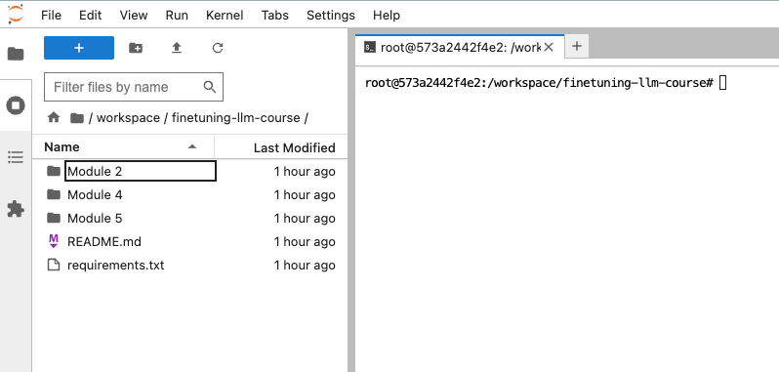
How the code setup should look

Slide 25

The Secret Sauce behind LLMs & Limitations
Recipe to get state-of- the-art results in NLP
Pretraining on web-scale data Finetuning on downstream task
Scaling Laws
The larger the Deep Learning/AI model, the better the performance.
Limitations of full fine- tuning approaches
Compute Storage
How to Finetune very large models on consumer hardware?

Slide 26
What makes a model large?
Two Factors
Number of parameters
Precision of the data type
30
GPU memory required to load the model in Gigabytes GB
25
1
20
15
2
10
Let’s put some numbers wrt Mistral-7B model with 7 Billion parameters
5
0
FP16/BF16 INT8
Precision of the datatype
FP32
INT4/NF4

Slide 27
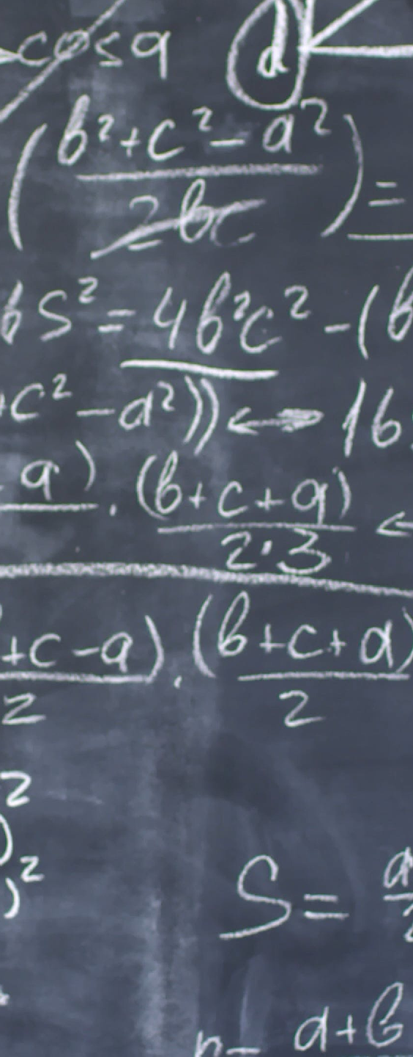

Why full finetuning is expensive?
Finetuning Mistral-7B in mixed-precision using Adam Optimizer
Weights - 2 bytes / parameter
Gradients - 2 bytes / parameter
Optimizer state - 4 bytes / parameter FP32 copy) +
8 bytes / parameter (momentum & variance estimates)
Total training cost: 16 bytes/parameter * 7 billion parameters = 112 GB

Slide 28
Why PEFT?
As models get larger and larger, full fine-tuning becomes infeasible to train on consumer hardware.

Slide 29
Why PEFT?
As models get larger and larger, full fine-tuning becomes infeasible to train on consumer hardware.
In addition, storing and deploying fine-tuned models independently for each downstream task becomes very expensive, because fine-tuned models are the same size as the original pretrained model.

Slide 30
What is PEFT?
Methods that allow us to fine-tune a large pretrained model on a specific downstream task while requiring significantly fewer parameters than full fine-tuning.

Slide 31
What is PEFT?
Methods that allow us to fine-tune a large pretrained model on a specific downstream task while requiring significantly fewer parameters than full fine-tuning.
The goal is to achieve comparable or even better performance than full fine-tuning, while requiring less computation and memory resources.

Slide 32
How does PEFT works?

Slide 33
How does PEFT work?
PEFT approaches only fine-tune a small number of (extra) model parameters while freezing most parameters of the pretrained LLMs, thereby greatly decreasing the computational and storage costs.

Slide 34
How does PEFT work?
PEFT approaches only fine-tune a small number of (extra) model parameters while freezing most parameters of the pretrained LLMs, thereby greatly decreasing the computational and storage costs.
Adapts to the downstream task while reducing the risk of catastrophic forgetting.

Slide 35
How does PEFT work?
PEFT approaches only fine-tune a small number of (extra) model parameters while freezing most parameters of the pretrained LLMs, thereby greatly decreasing the computational and storage costs.
Adapts to the downstream task while reducing the risk of catastrophic forgetting.
Prevents overfitting

Slide 36
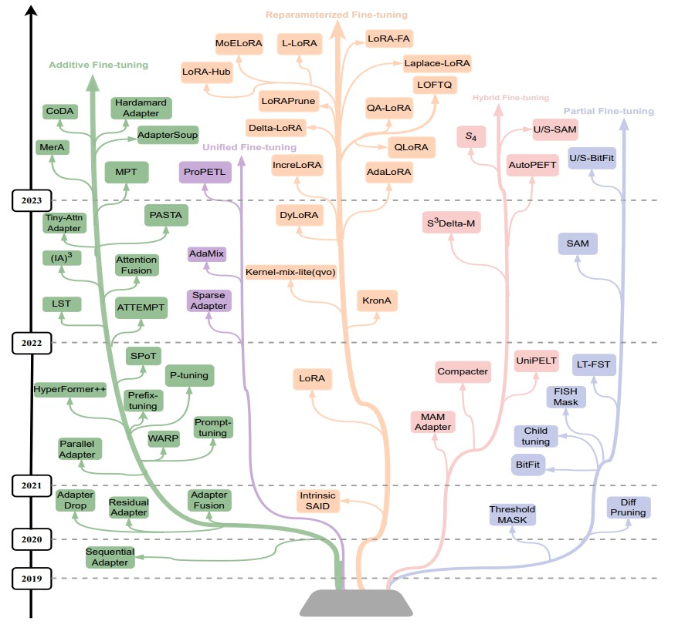
Types of PEFT approaches
Approaches we will be looking at in this course:
1
Prompt Tuning, Prefix Tuning, Adaptation Prompt
2
LoRA, QLoRA, AdaLoRA,
LoftQ, LoHA, LoKR
3
IA³ , Bottleneck Adapters
PARAMETER-EFFICIENT FINE-TUNING METHODS FOR PRETRAINED LANGUAGE MODELS: A CRITICAL REVIEW AND ASSESSMENT

Slide 37


How to use PEFT methods in practice?
Democratize finetuning of large AI models on consumer hardware while being simple, efficient and extendable
Focus on Usability and Simplicity
Interoperability and Integration with Hugging Face ecosystem
Community-Driven Development - 100+
Contributors, used by 3K+ dependents and 12K+
models on the hub

